Slide 1
Why are people special?
Gen. 1:26-27, 5:3, 9:6; Rom. 8:29-30, 12:2; 1 Cor. 15:47-49; 2 Cor. 3:17-18; Col. 1:15, 3:7-10

Slide 2
We are created in God’s image.
Image is likeness.

Slide 3
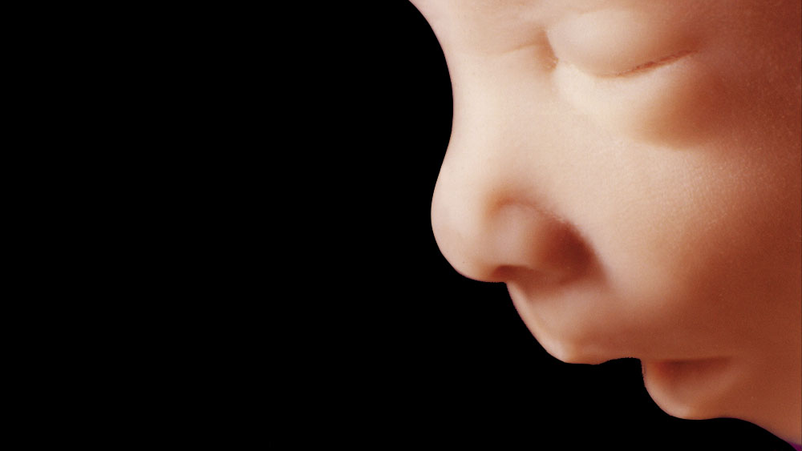

Slide 4
We are created in God’s image.
Image is likeness.
God’s image is 3-in-1.
God is Father, Son, Spirit.
We are soul, body, spirit.
We are intellect, emotion, will.
Bearing the image of God makes us special.

Slide 5
We strive to conform to God’s image.
God designed us to be like Christ.
God’s image is very different than the world.

Slide 6
We will be completely in God’s image.
Physically, we are born of this earth.
We must also be born spiritually.
God is transforming us through His Spirit and word into His complete image.

Slide 7
"Whoever sheds the blood of man, by man shall his blood be shed, for God made man in his own image.”
Genesis 9:6

Slide 8
People are in God’s image.
People are not mere animals.
People are special to God.
All people should be special to me.

Slide 9
I must become like Christ.
God designed me to be that way.
I must be odd to the world.
I must remove some things from my life and add others.

Slide 10
I will be complete in Christ.
We must be born again!
I must be in His word and prayer to be transformed.

