Slide 2
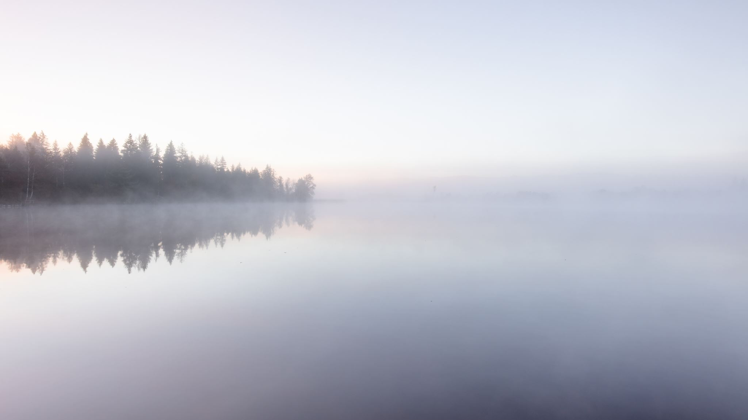
The Amazing Grace of God
1 Timothy 1:12-20

Slide 3
God’s grace stretches to unbelievers.

Slide 4
God’s grace sanctifies sinners.

Slide 5
God’s grace sustains the faithful.

Slide 6
How does that apply to me?

Slide 7
We are not beyond God’s amazing grace.

Slide 8
Our friends, family, coworkers and neighbors are not beyond God’s amazing grace!

Slide 9
We are sinful people, but God is merciful!

Slide 10
Our lives should be an example of God’s grace, mercy and patience!

Slide 11
The stakes are high.

Slide 12
I need to focus on God’s grace and faithfulness, not my weaknesses!

